Slide 1
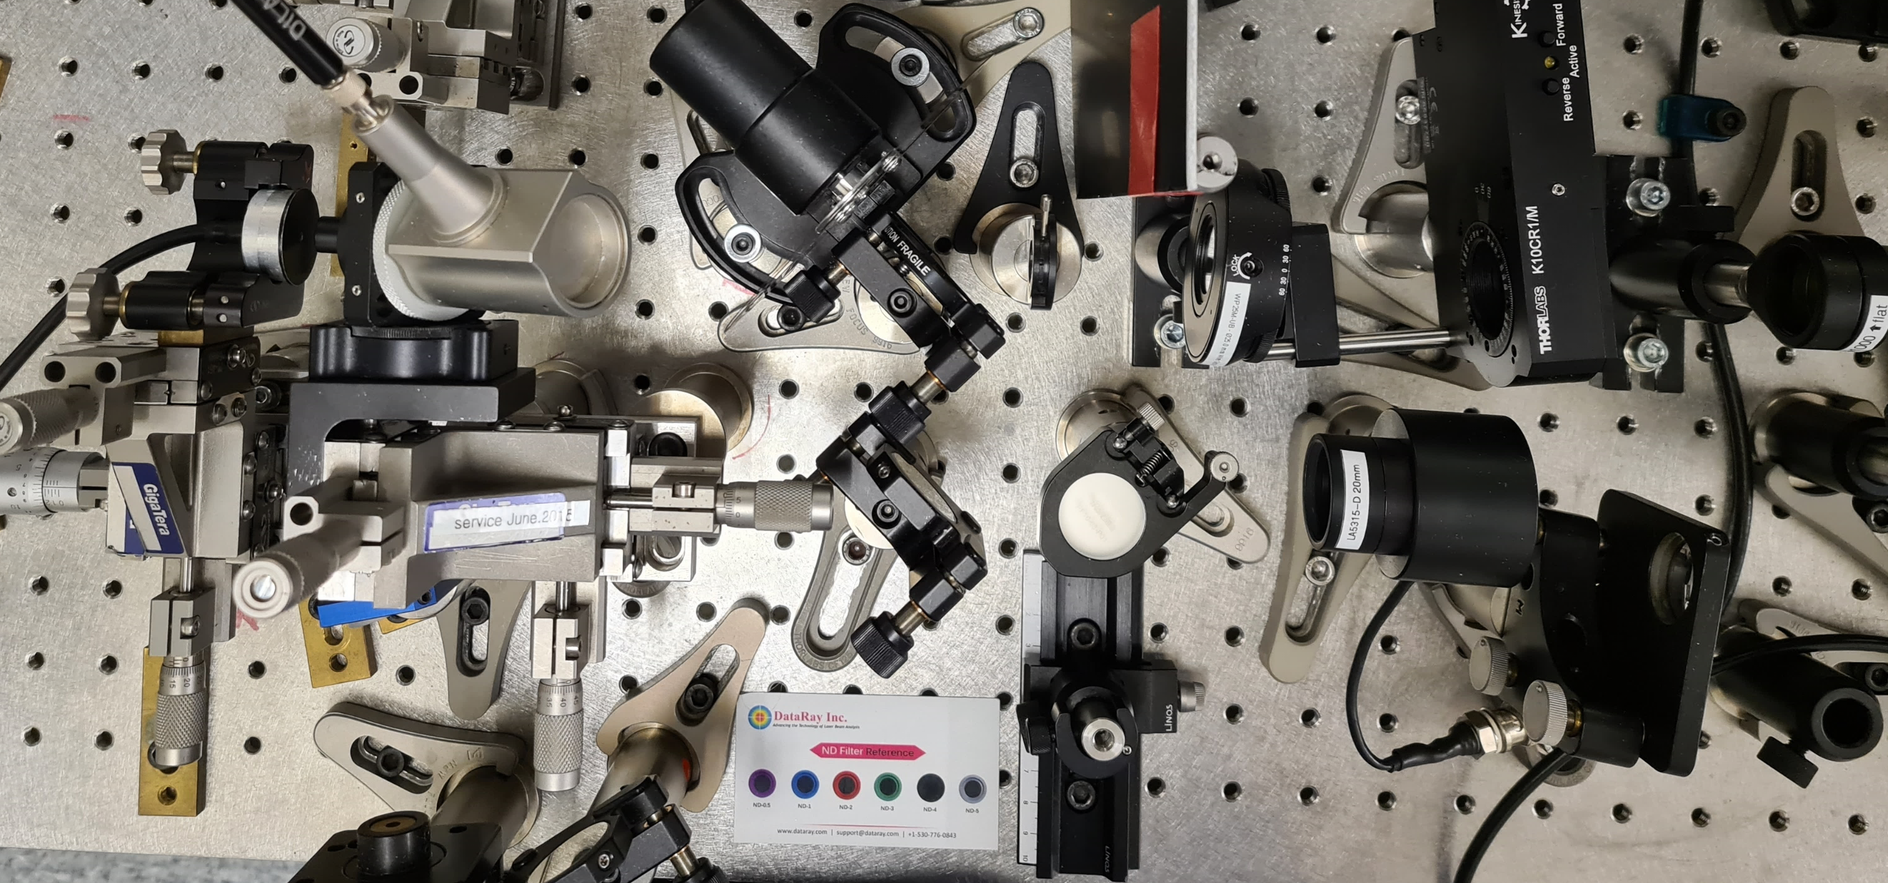
Measuring gain saturation of novel 2-µm pump DBR VECSEL
Ulrich Sauter
Semesterproject, 30. Mai 2023
Ultrafast Laser Physics, Prof. Ursula Keller
Department of Physics, Institute for Quantum Electronics, ETH Zurich, Switzerland
Notes:
Was here for a couple of wekks for my semsterproject
Where I looked at the gain saturation of a new type of vecsel which has a DBR for the pump wavelength integrated in the design
This new kind of vecsel

Slide 2
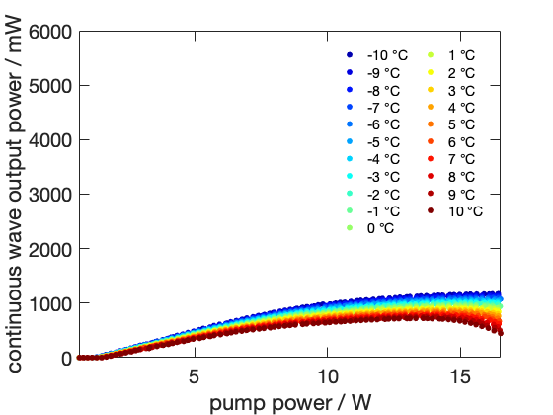
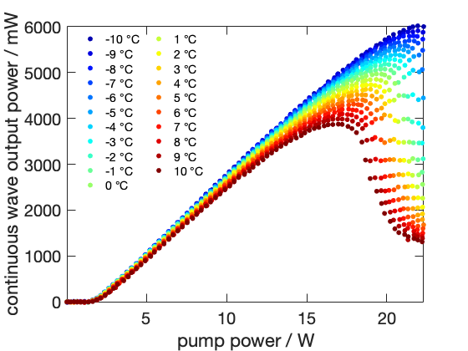
Pump DBR VECSEL – A novel VECSEL design
In CW operation
Increase of efficiency by 18%
6 times the output power
In modelocked operation
So far, no comparable improvement
Investigate gain saturation
Without pump DBR
With pump DBR
Notes:
This new design shows remarkable performance in efficiency and power scaling compared to their counterpart without pump DBR during continuous wave operation
As illustrated with the powerslopes you can see ere on the right of the two different designs, to see there different performance. And to put some numbers to it:
However in the modelocked operation we don’t obvserve an comparable improvement.
To gain insight into this behavior, I investigated the gain saturation of these chips, which is a first this new VECSEL design

Slide 3
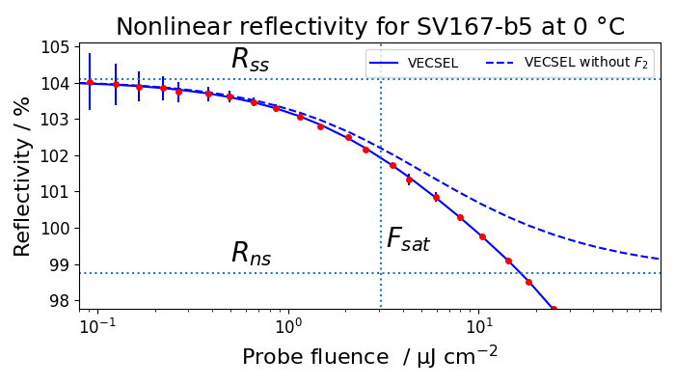
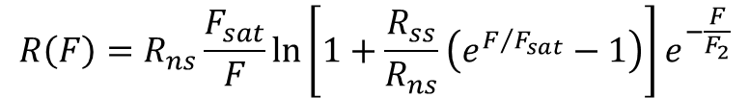
Gain saturation
Gain saturation
Information about chip performance
Optimizing cavity design
Dependency on structure, temperature and pump power
Measurements
4 different VECSEL chips
3 temperatures -10 °C, 0 °C, 10 °C
9 different pump powers from 0 W to16 W
108 measurements 10 min each
Automate one of the parameters
$$R\left(F\right)=R_{ns}\frac{F_{sat}}{F}\ln\left[1+\frac{R_{ss}}{R_{ns}}\left(e^{F/{F_{sat}}}−1\right)\right]e^{−\frac{F}{F_{2}}}$$
Notes:
In a gain saturation measurement, one measures the nonlinear behavior of the reflectivity from the chip versus prope fluence.
And also allows us to better choose a suitable SESAM for pulsed laser operation
Therefore for my measurements we chose the following parameters to asses their effect on the gain saturation
So I though about how can make this measurement process more efficient, in terms of that it takes less time and that I have more time in between during a measurement.
And I came up with the idea to automate one of the measurements parameters. There are the following three parameters which I need to think about

Slide 4
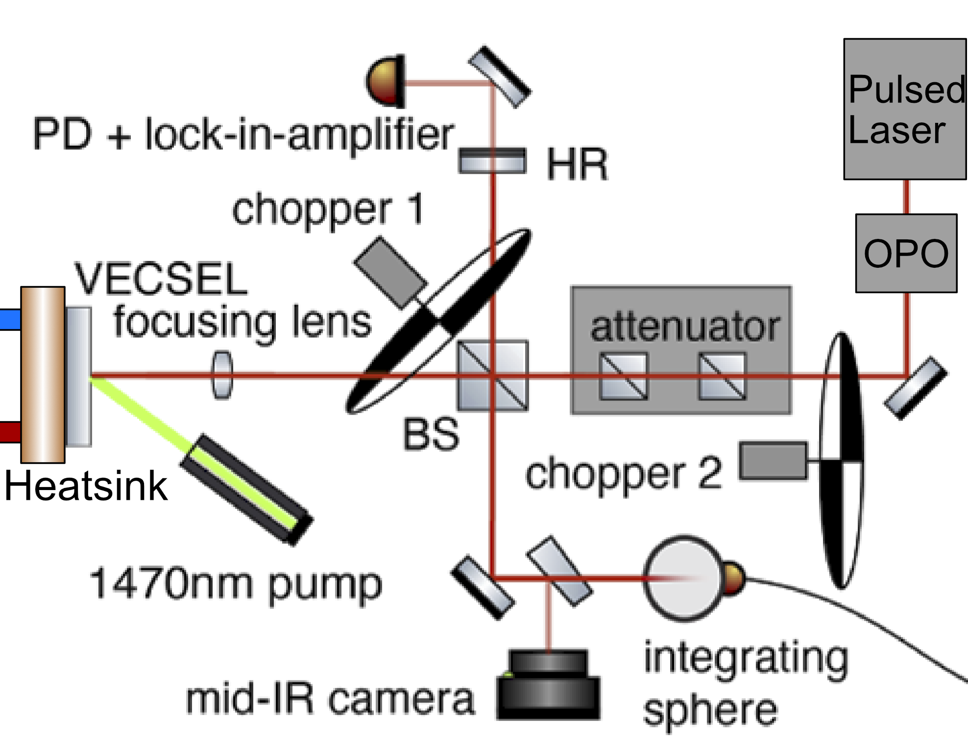
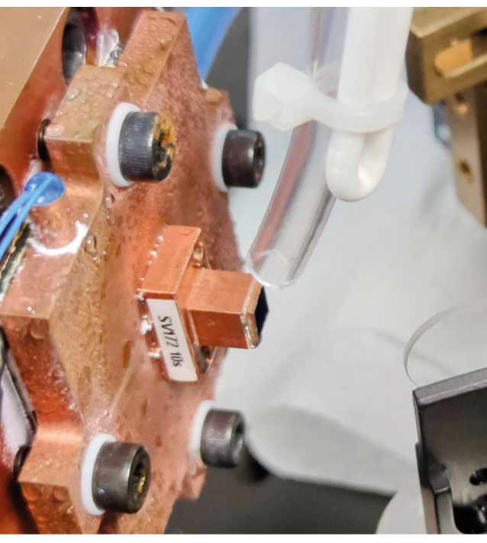
Measurement Setup
Setup located in the SESAM lab
VECSEL chip: screwed on heatsink
Temperature: Peltier-controlled heatsink
Pump power: Diode laser for optical pumping
Image adopted from: M. Gaulke et al, Optics Express 29, 40360-40373 (2021)
Notes:
The measurement setup is located…
Lets go over our parameters again and look how they are set in the setup
Temperautre is managed over a peltier element which is connect to a temperature controller. But since we measure only for 3 temperatures
There isn’t much time to gain here
Highest time saving potential for pump power
Controlled over a DC power supply which you can see

Slide 5
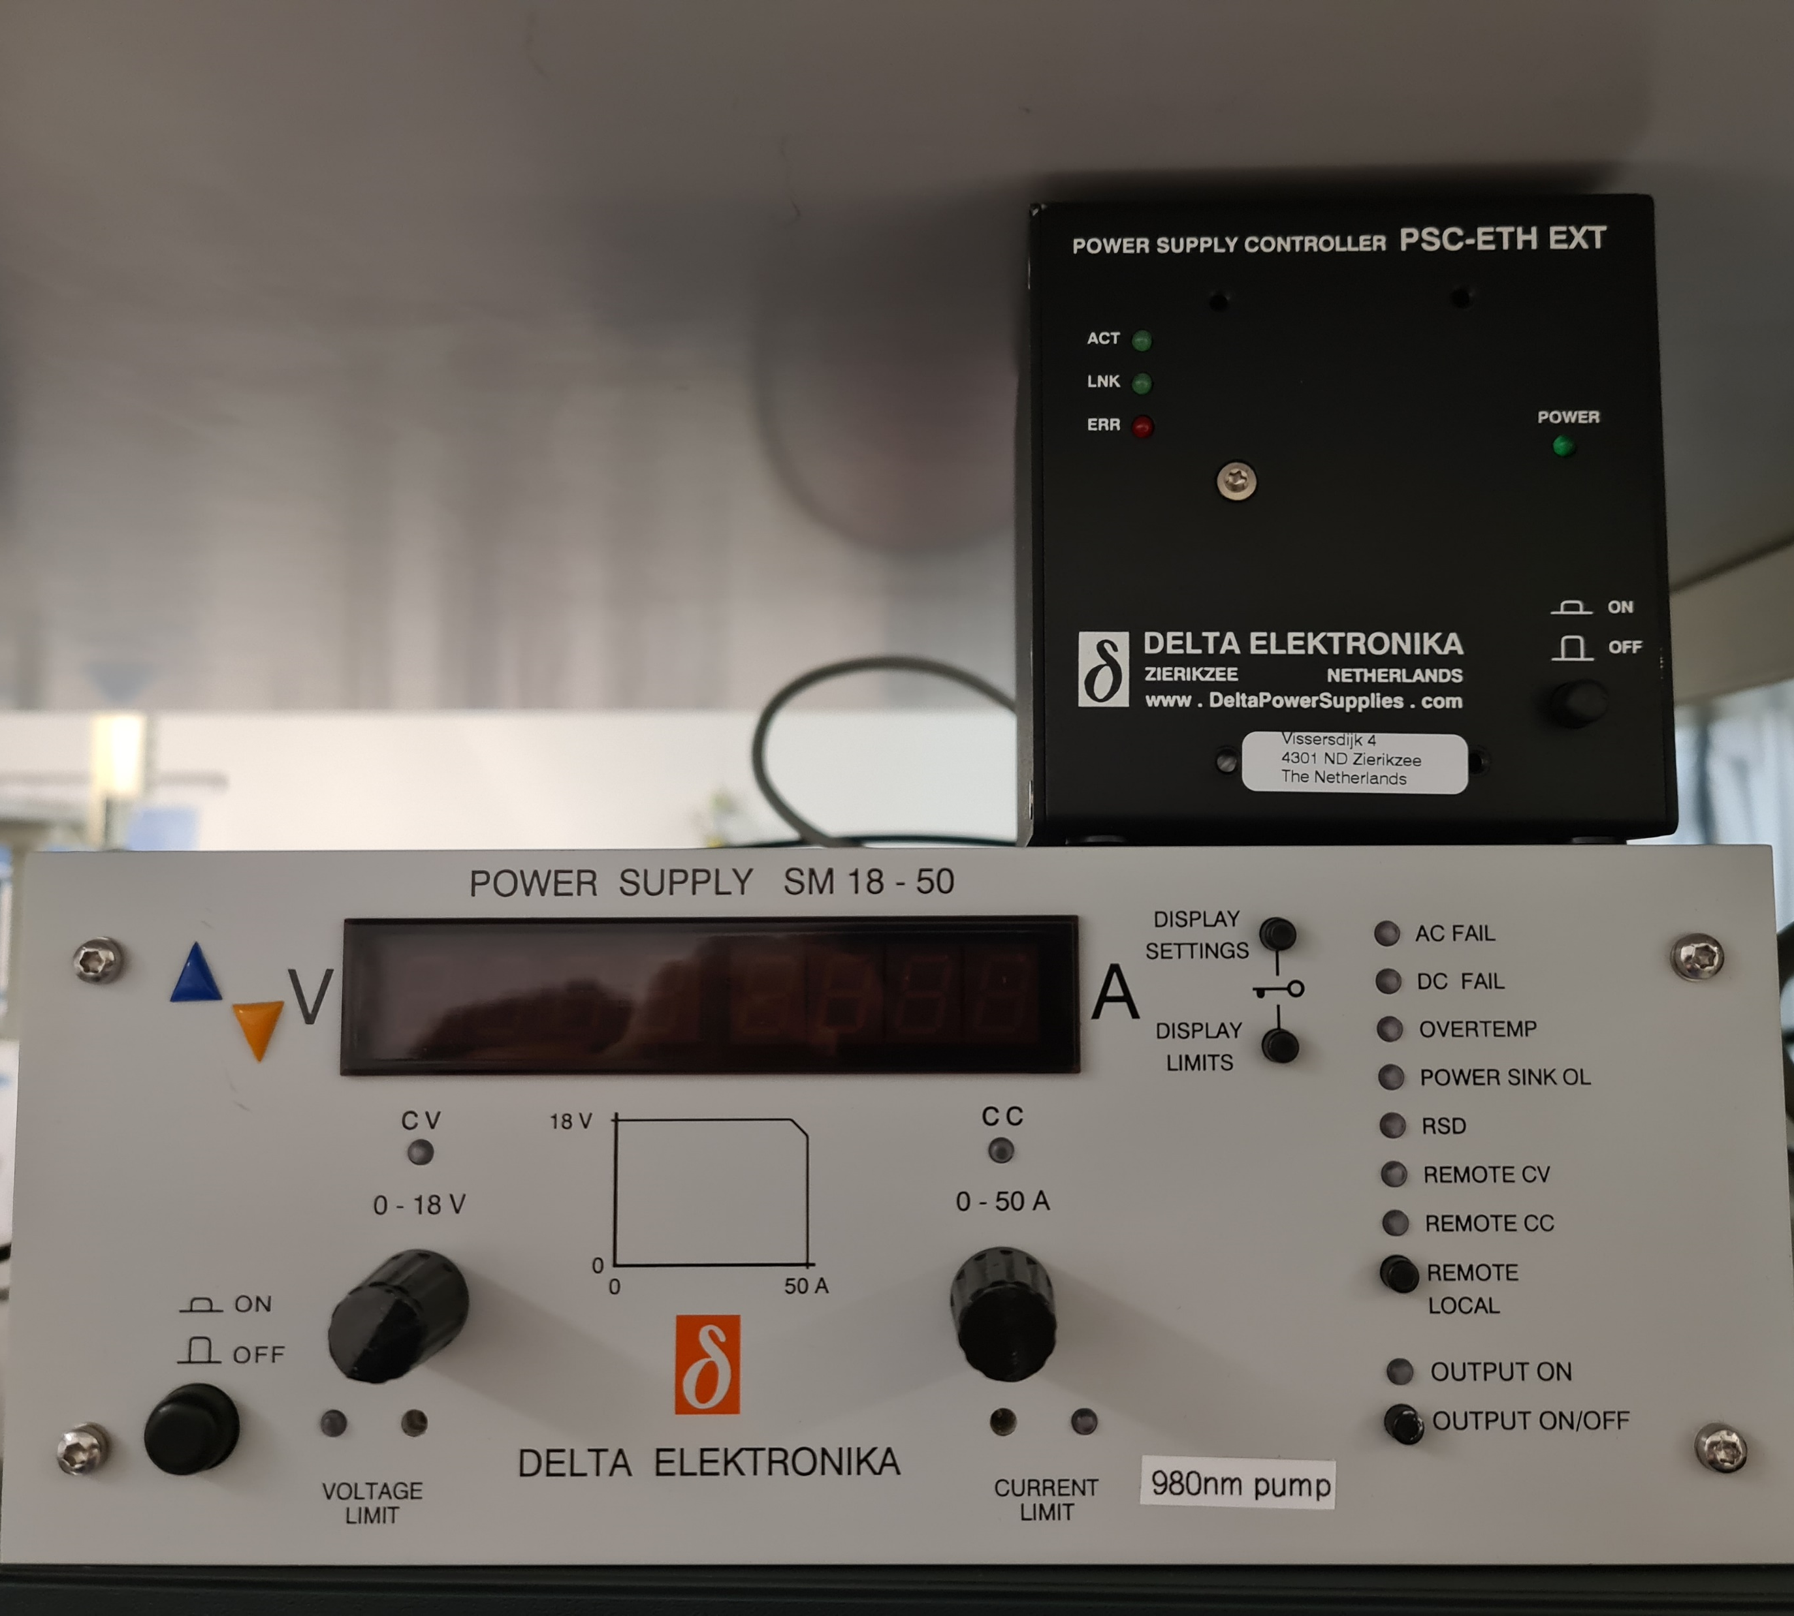
Measurement Setup
Setup located in the SESAM lab
VECSEL chip: screwed on heatsink
Temperature: Peltier-controlled heatsink
Pump power: Diode laser for optical pumping
Improvement of setup
→ Automate control of pump power
Image adopted from: M. Gaulke et al, Optics Express 29, 40360-40373 (2021)
Notes:
Here on the bottom of the picture
And on top of it you can see this black box which is a serial interface for the power supply.
This allowed me to plug a computer into it and write some software to controle the power supply and therefore the pump power
The whole setup had already a very nice user interface which you can see here

Slide 6
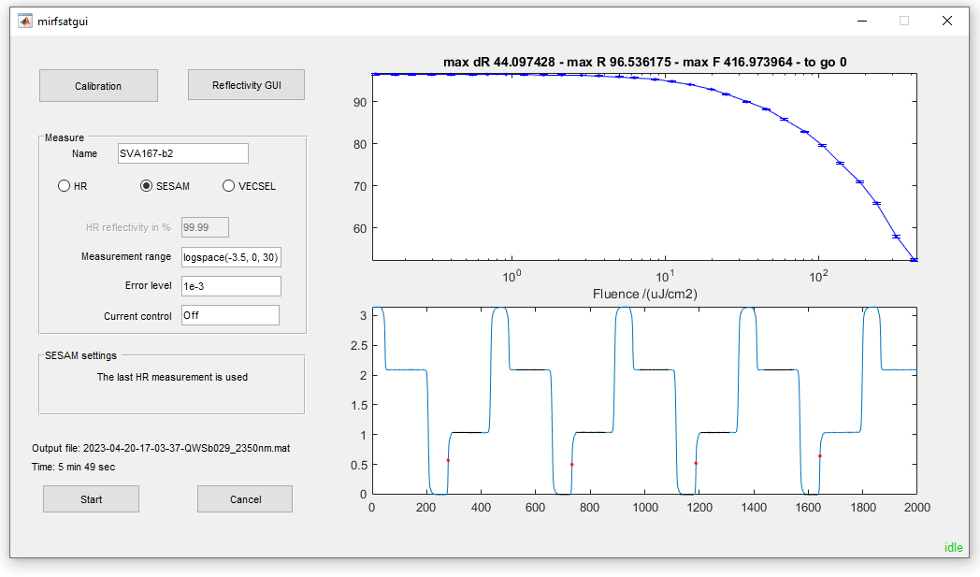
Measurement Setup
[0 10 16]
Integrated into existing software
Notes:
This made the integration of the automated pump control a straightforward process.
To then enter the desired pump powers or rather current values I added this text box from where I list of currents can be typed in to regulate the power supply
Now that the controlling part is all figured out and working. I ran into a different problem during the first measurement
This problem was already known but until then it was not so critical as it is for the automation.
The problem had to do with how the software analyzed the measured signal from the setup
Before we talk about the problem lets first have a look at how the measured signal looks like

Slide 7
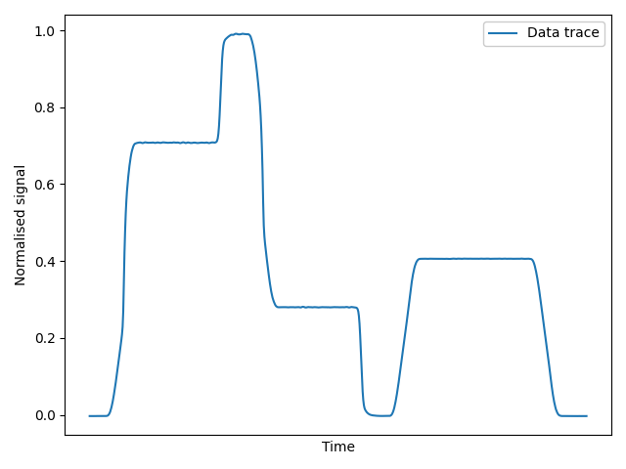
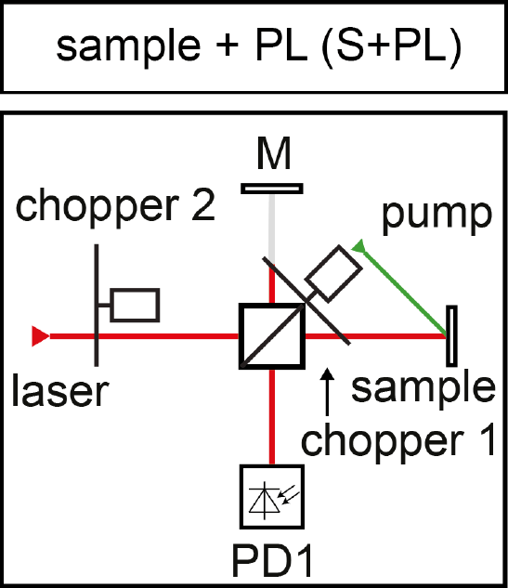
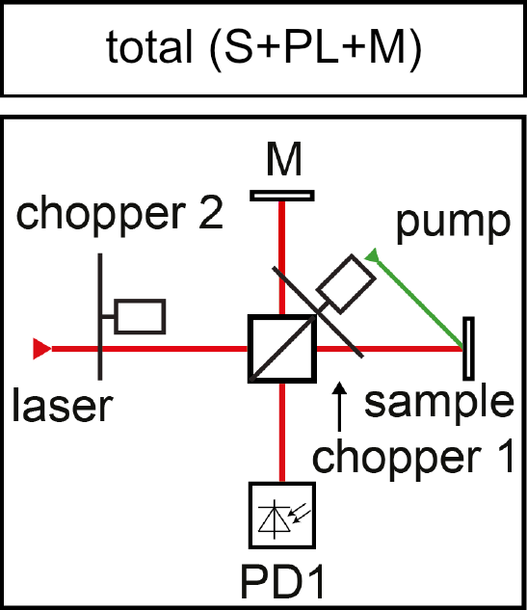
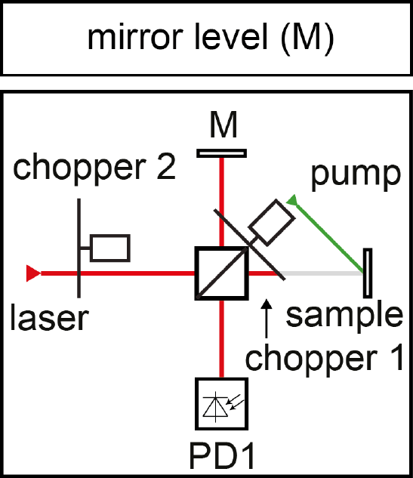
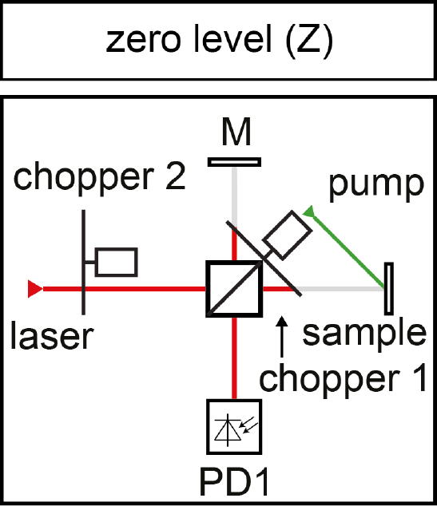
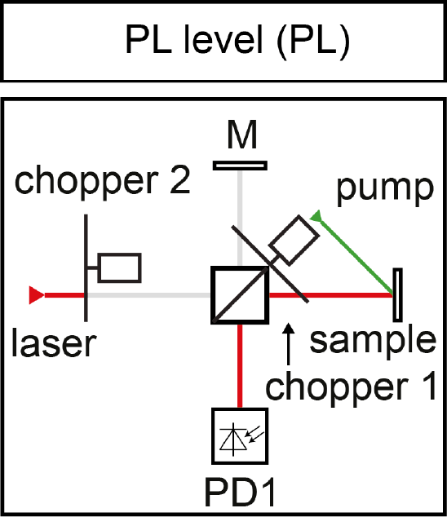
Signal analysis
S+PL+M
S+PL
PL
M
Z
Right images adopted from M. Mangold et al, Optics Express 20(4), 4136–4148 (2012)
Notes:
Here we see a single cycle of a measurement
A typical measurement corresponds to about 200 of these cycles
These cycles are produces by two choppers in the setup which you can see
one directly blocks the laser beam and the other is placed such that it intercept two of the arms like shown in the picture
Depending on the state of the choppers we can observe 5 different signal levels in our trace
First we have that only the beam from the signal arm gets measured
which corresponds to sampel signal and PL from gain chip since optically pump the chip, noticable in the low fluence regime
Then we have the state where both beam paths are open and we measure everything
After that just the reference arm with the high reflexion mirror than both are blocked
Now due to the second chopper we also get a state where the laser beam gets fully blocked so that we can measure just the pl level
Which then allows us to get just the response from our sample which we then can compare to the reflectivity of the high reflection mirror
So that is how the signal gets produced, now lets look at how the software evaluates the different levels

Slide 8
Triggering method
Original method:
Notes:
The original method used before worked like this
Explain what a trigger is

Slide 9
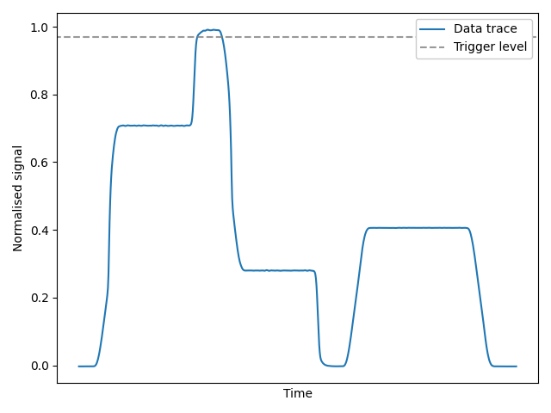
Triggering method
Original method:
Set a trigger level

Slide 10
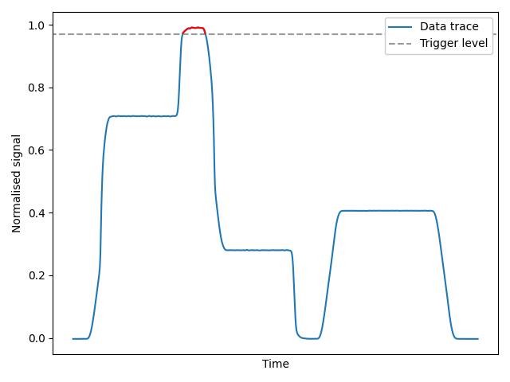
Triggering method
Original method:
Set a trigger level
Look for all points above a set level

Slide 11
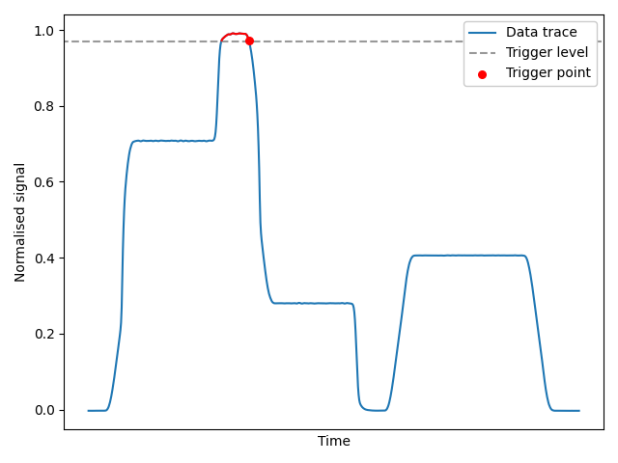
Triggering method
Original method:
Set a trigger level
Look for all points above a set level
Place the trigger once signal drops below that level

Slide 12
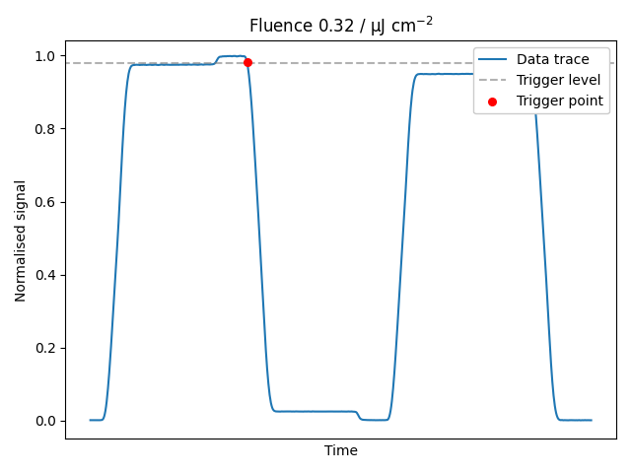
Triggering method
Original method:
Set a trigger level
Look for all points above a set level
Place the trigger once signal drops below that level
Has problems with triggering
Notes:
Here I have prepared an animation of the signal from measurement
Notice how the trigger level is already just above the simple signal, so we cant go much lower

Slide 13

Triggering method
Original method:
Set a trigger level
Look for all points above a set level
Place the trigger once signal drops below that level
Has problems with triggering
Multi-triggering due to
Fluctuation of laser power
Electronic amplification
Measurement unusable
Manually adjusting of trigger level
Notes:
As you can see we have multiple trigger points.
Meaning that measurement would be unusable and needed to be repeated.
And for the repeat measurement one had to manually adjust the trigger level and hope that it works.
Which sounds not so goo d for an automated process
Now more generally I narrowed it down to two cases in which we can get false triggers

Slide 14
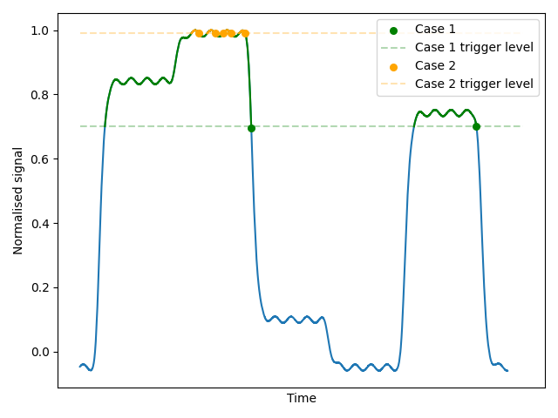
False triggering problem
Case 1: Trigger level too low
Triggers on strong PL signal
→ Only trigger on main peak
Case 2: Trigger level too high
Triggers on noise or fluctuation of laser
→ Only trigger on long downslope
Notes:
To better visualize the different problem case, we have here simulated data with exaggerated noise

Slide 15
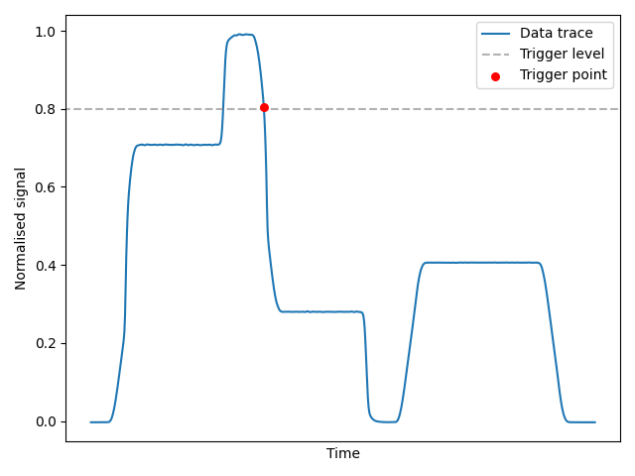
Improved trigger detection
Expanded existing logic:
Use original method with low trigger level → Removes triggers on noisy full signal

Slide 16
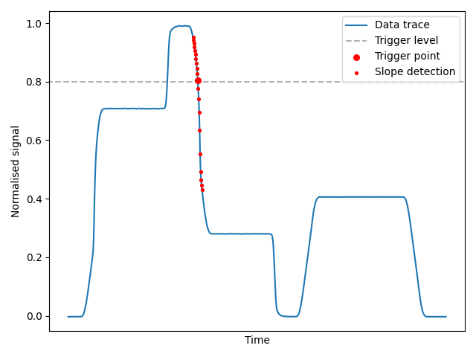
Improved trigger detection
Expanded existing logic:
Use original method with low trigger level → Removes triggers on noisy full signal
Check if point is on a descending slope → Removes triggers on noisy PL signal

Slide 17
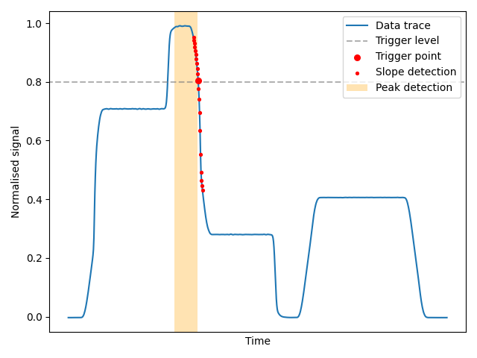
Improved trigger detection
Expanded existing logic:
Use original method with low trigger level → Removes triggers on noisy full signal
Check if point is on a descending slope → Removes triggers on a noisy level
Check if it a maximum is close → Trigger on main peak
→ Resolved false triggering
→ Autonomous measurement time increase to 85 min
Notes:
Decreases measurement time from 90 mins of the 9 measurements to 85 min
We are done now in term so automating the setup.
Lets go back to talk about the measurements.
What I haven’t talked about is the different chips I investigated
Lets now look at the different vecsel chips, which I investigated

Slide 18
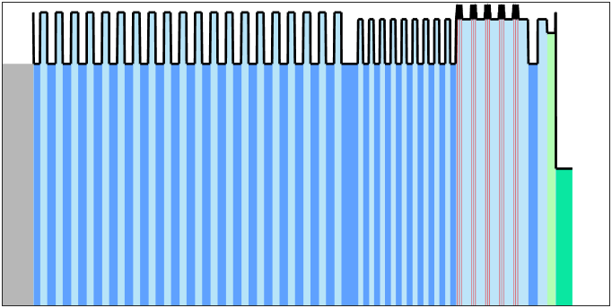

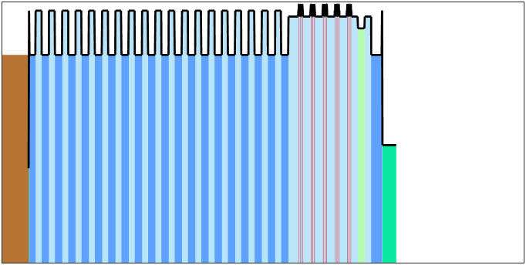
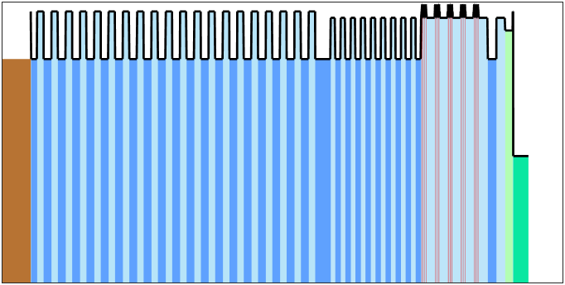
Overview of the chips
Name | Diamond, pump DBR | Copper, pump DBR | No pump DBR | Hybrid mirror
Design
Mirror | 19 laser DBR pairs 8 pump DBR pairs | 19 laser DBR pairs 8 pump DBR pairs | 19 laser DBR pairs No pump DBR | Hybrid mirror Cu layer + 10.5 p. DBR
Heat spreader | Diamond | Copper | Copper | Diamond
Length | 10 µm | 10 µm | 8 µm | 5 µm
Notes:
The first two chips have the same structure but they have a different heatsink. One is diamond and the other copper. Here we wanted to see how big the differences

Slide 19
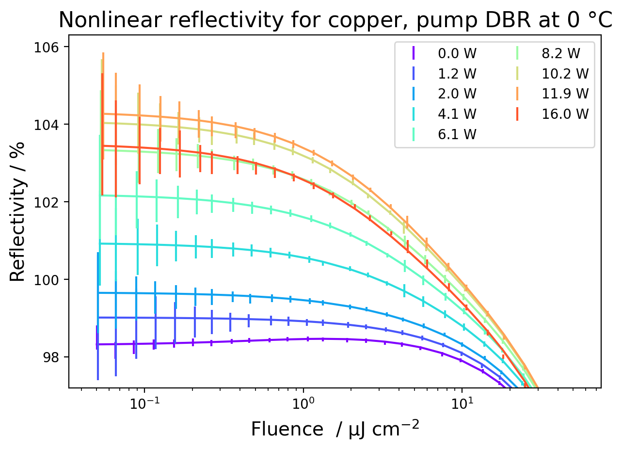
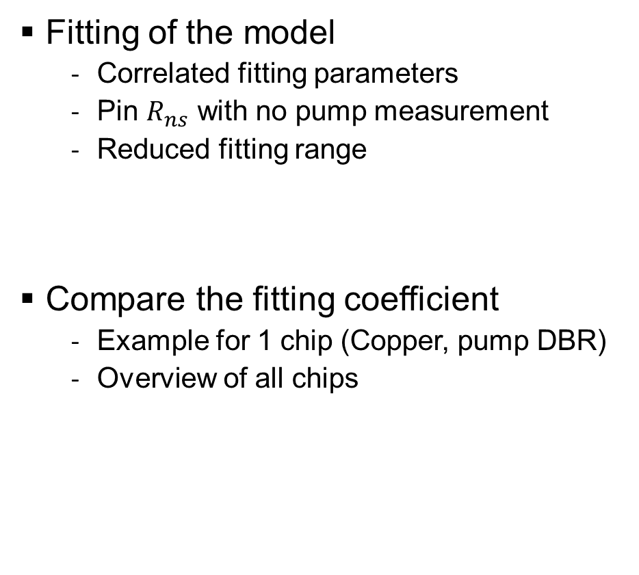
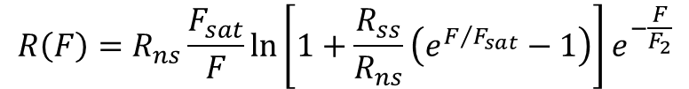
Data evaluation
Fitting of the model
Correlated fitting parameters
Pin $R_{ns}$ with no pump measurement
Reduced fitting range
Compare the fitting coefficient
Example for 1 chip (Copper, pump DBR)
Overview of all chips
$$R\left(F\right)=R_{ns}\frac{F_{sat}}{F}\ln\left[1+\frac{R_{ss}}{R_{ns}}\left(e^{F/{F_{sat}}}−1\right)\right]e^{−\frac{F}{F_{2}}}$$
Notes:
Correlated fit parameters
Pin non saturable loses with the measurement without the pump

Slide 20
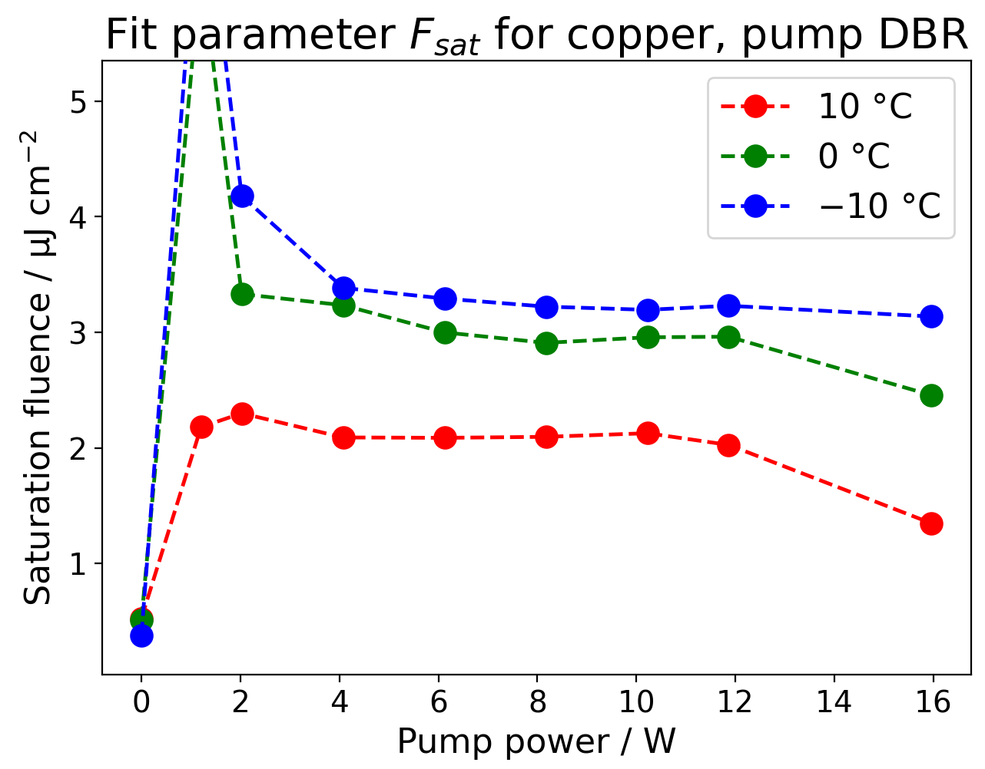
Parameter saturation fluence $F_{sat}$
After inversion stays constant
Temperature influence:
Lower temperature leads to higher saturation fluence
Nonlinear behavior for temperatures
Notes:
So what the measurements typically show is that, after our active region reaches population inversion.
- The outliers you see at 1W is because the fitting method could really determine a good saturation fluence because the measured reflectivity was really flat around the 100% mark

Slide 21
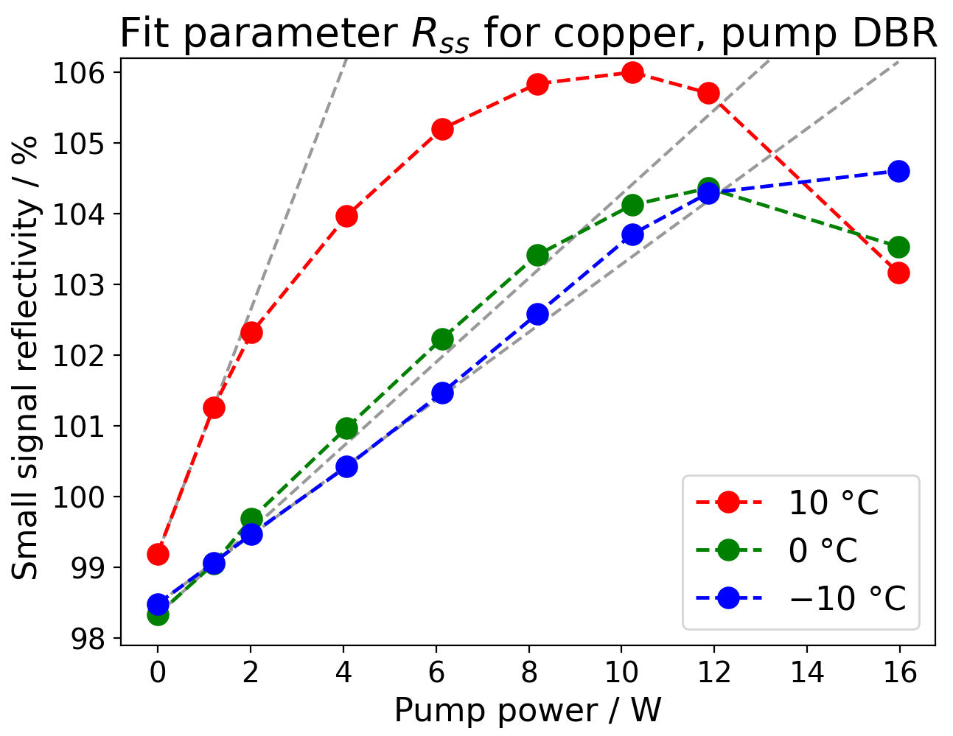
Parameter small signal reflectivity $R_{ss}$
Temperature shifts resonance of gain QW → Different max reflectivity
Linear growth with pump power
Sub-linear growth sooner for higher temperature
Temperature | 10 °C | 0 °C | -10 °C
Break-away power | 1 W | 8 W | 12 W
Notes:
If we look at the plot on the right, the first thing one notices here is that, we see that the 10C curve has a much higher reflectivity then the ones at cooler temperatures. This seems counterintuve, but this can be explained by
As expected for lower pump powers we see a linear dependency of the small signal reflect on the pump power

Slide 22
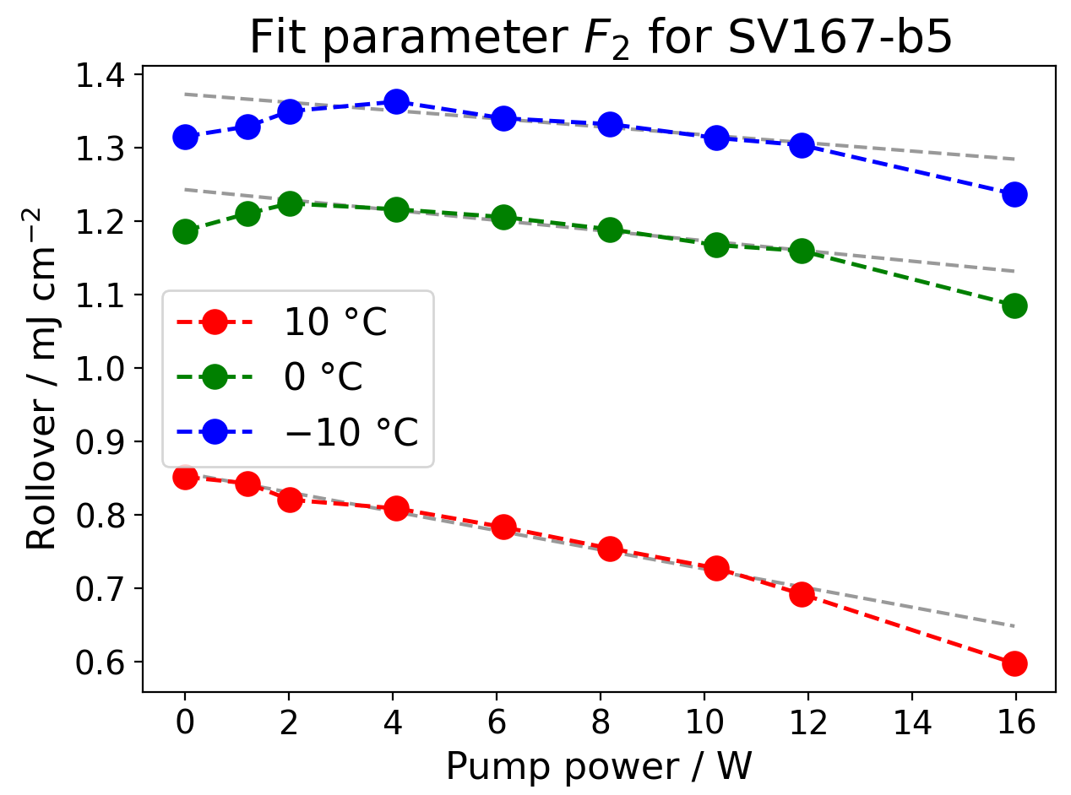
Parameter rollover $F_{2}$
Linear dependency on pump power
Temperature influence:
Lower temperature increases value
Nonlinear behavior for temperatures

Slide 23
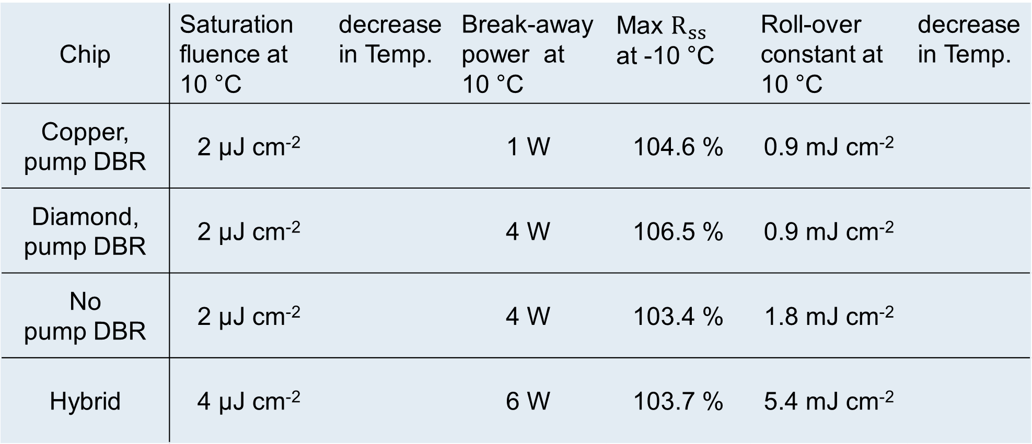
Overview – Chips
Chip | Saturation fluence at 10 °C | decrease in Temp. | Break-away power at 10 °C | Max $R_{ss}$ at -10 °C | Roll-over constant at 10 °C | decrease in Temp.
Copper, pump DBR | 2 μJ cm⁻² |  | 1 W | 104.6 % | 0.9 mJ cm⁻²
Diamond, pump DBR | 2 μJ cm⁻² |  | 4 W | 106.5 % | 0.9 mJ cm⁻²
No pump DBR | 2 μJ cm⁻² |  | 4 W | 103.4 % | 1.8 mJ cm⁻²
Hybrid | 4 μJ cm⁻² |  | 6 W | 103.7 % | 5.4 mJ cm⁻²
Notes:
If we first compare the two chips with the same mirror configuration
We see overall they are very similar except for the break-away power and the max gain.
Also you might remember from the plot of Rss we have a strong shift in performance, most likely due to the strong heating of the pump and lesser cooling of the copper
As for when we compare no pump vs pump, we see the same saturation fluence but also much higher rss and also a lower roll-over constant for pump dbr
Now the rollover is most often attributed to two photon absorption and meaning we have a higher chance of two with the pump dbr, with the same active region
As for the hybrid chip, there we get a complete different picture compared to the others
And this is most likely because the hybrid chip uses a different active region then the others, therefore it doesn’t really makes sense to compare it to the others
Now if I compare my measurements to previous work

Slide 24
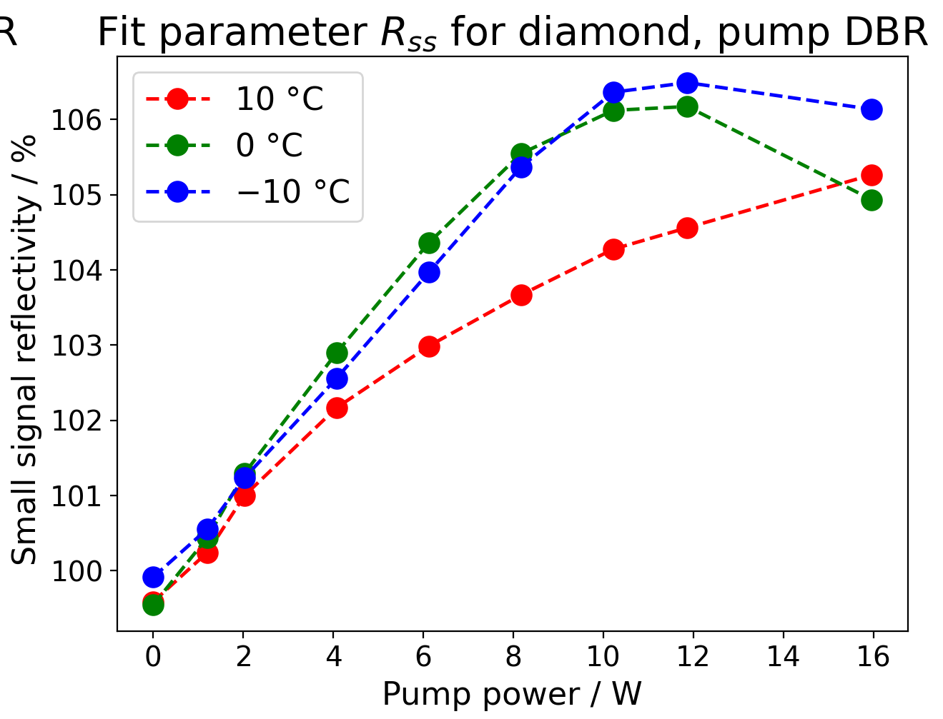
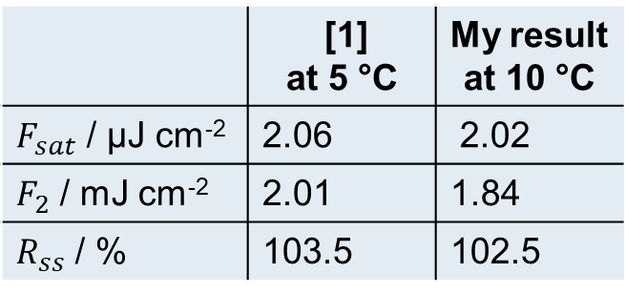
Comparison to previous work
 | [1] at 5 °C | My result at 10 °C
$F_{sat}$ / μJ cm⁻² | 2.06 | 2.02
$F_{2}$ / mJ cm⁻² | 2.01 | 1.84
$R_{ss}$ / % | 103.5 | 102.5
No pump DBR parameters comparable to [1]
Consistent measurements
Reliable results
New record small signal reflectivity of 106.5 %
[1] M. Gaulke, J. Heidrich, B. Ö. Alaydin, M. Golling, A. Barh, and U. Keller, Opt. Express 29, 40360-40373 (2021)
Notes:
I can only do that for the no pump dbr vecsel, where the same structure was used before in a puplication from Marco.
And as you can see in the taple I get very comparable results
So, I can say that my results are reliable and reproducible.
Also I could measure a new record small signal reflectivity of 106.5% for a backside cooled VECSEL

Slide 25
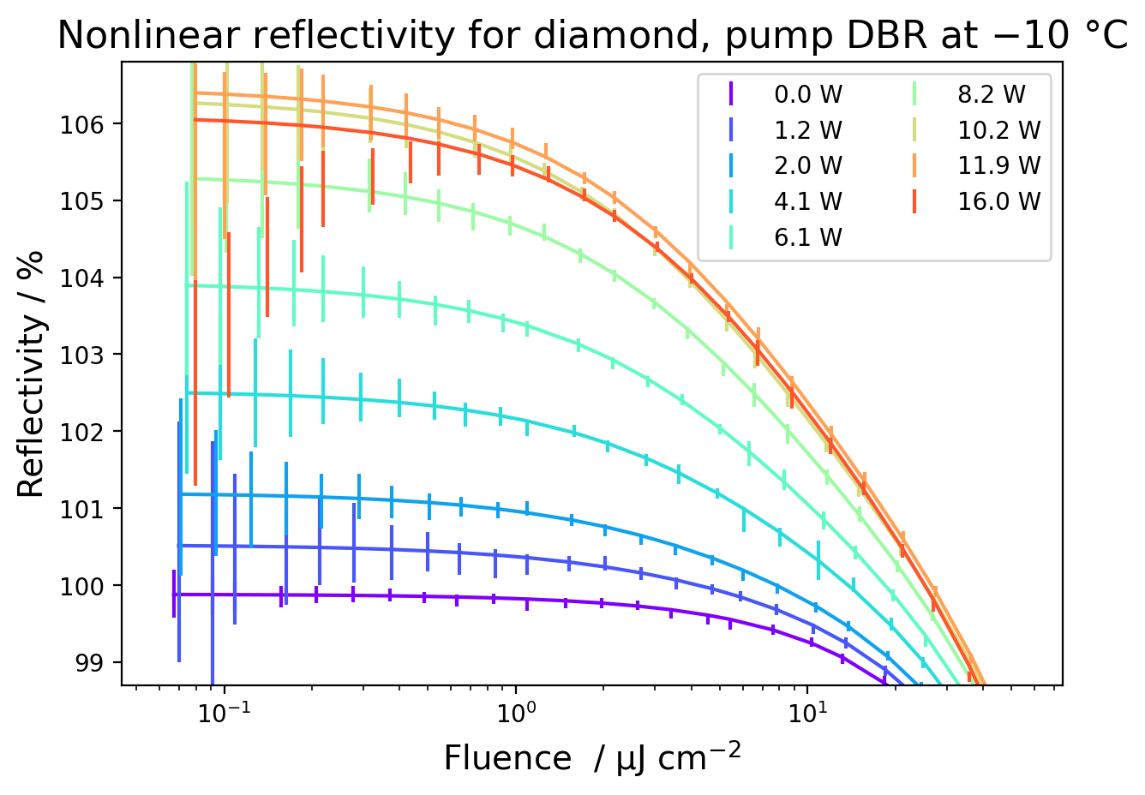
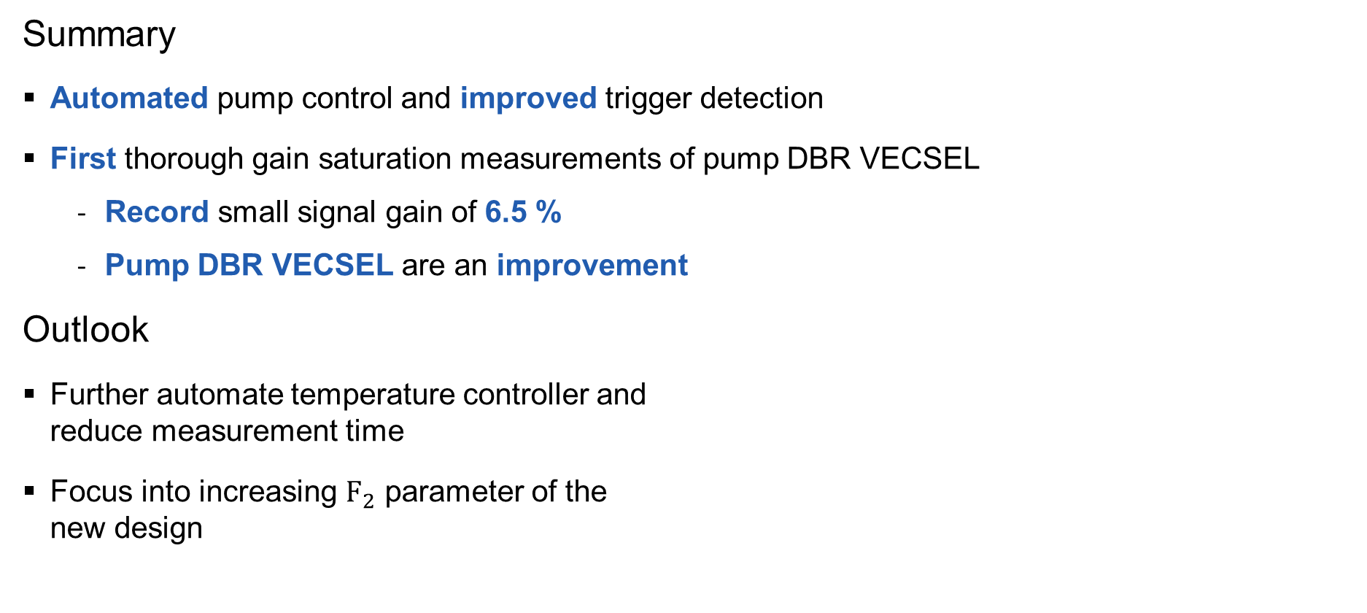
Summary & Outlook
Summary
Automated pump control and improved trigger detection
First thorough gain saturation measurements of pump DBR VECSEL
Record small signal gain of 6.5 %
Pump DBR VECSEL are an improvement
Outlook
Further automate temperature controller and reduce measurement time
Focus into increasing $F_{2}$ parameter of the new design
Notes:
Measure even faster and for longer
Increase F_2 by limiting two photon absorption

Slide 26
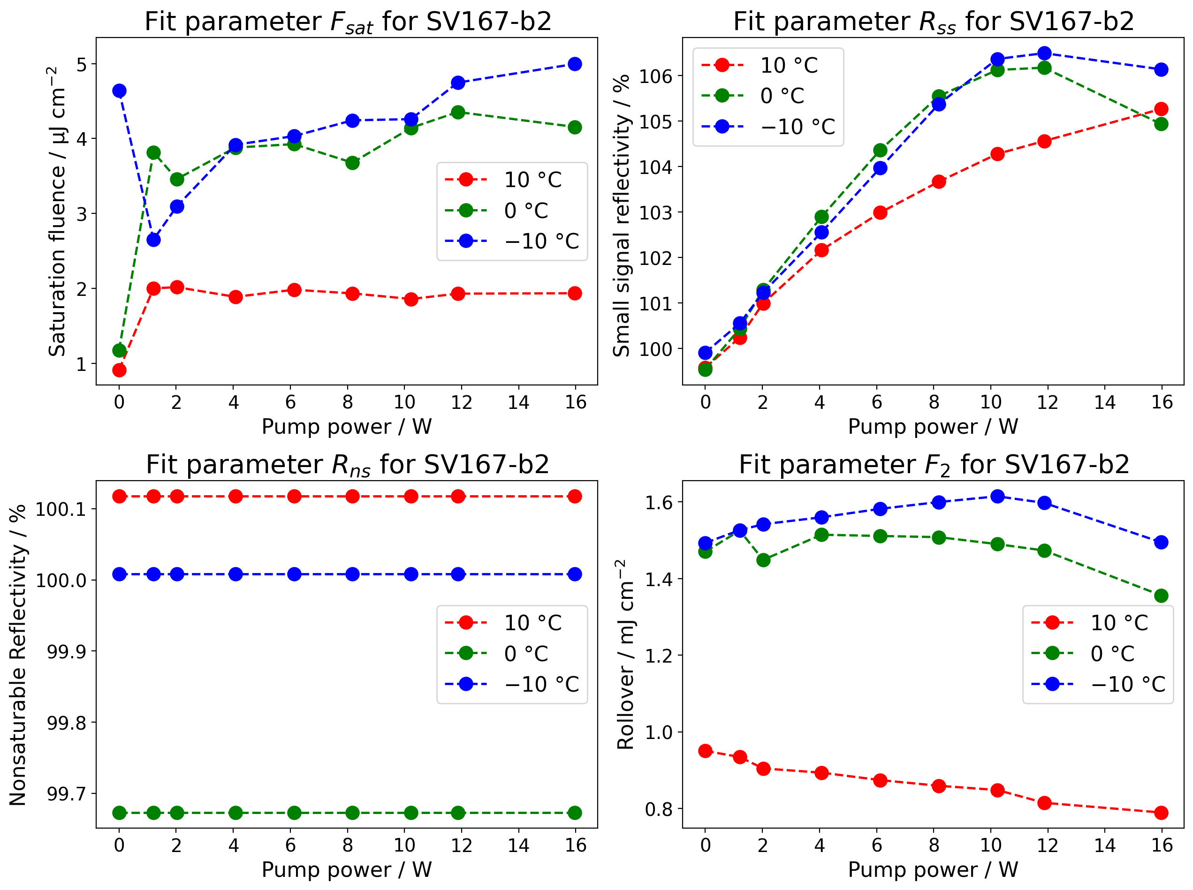
Overview diamond, pump DBR

Slide 27
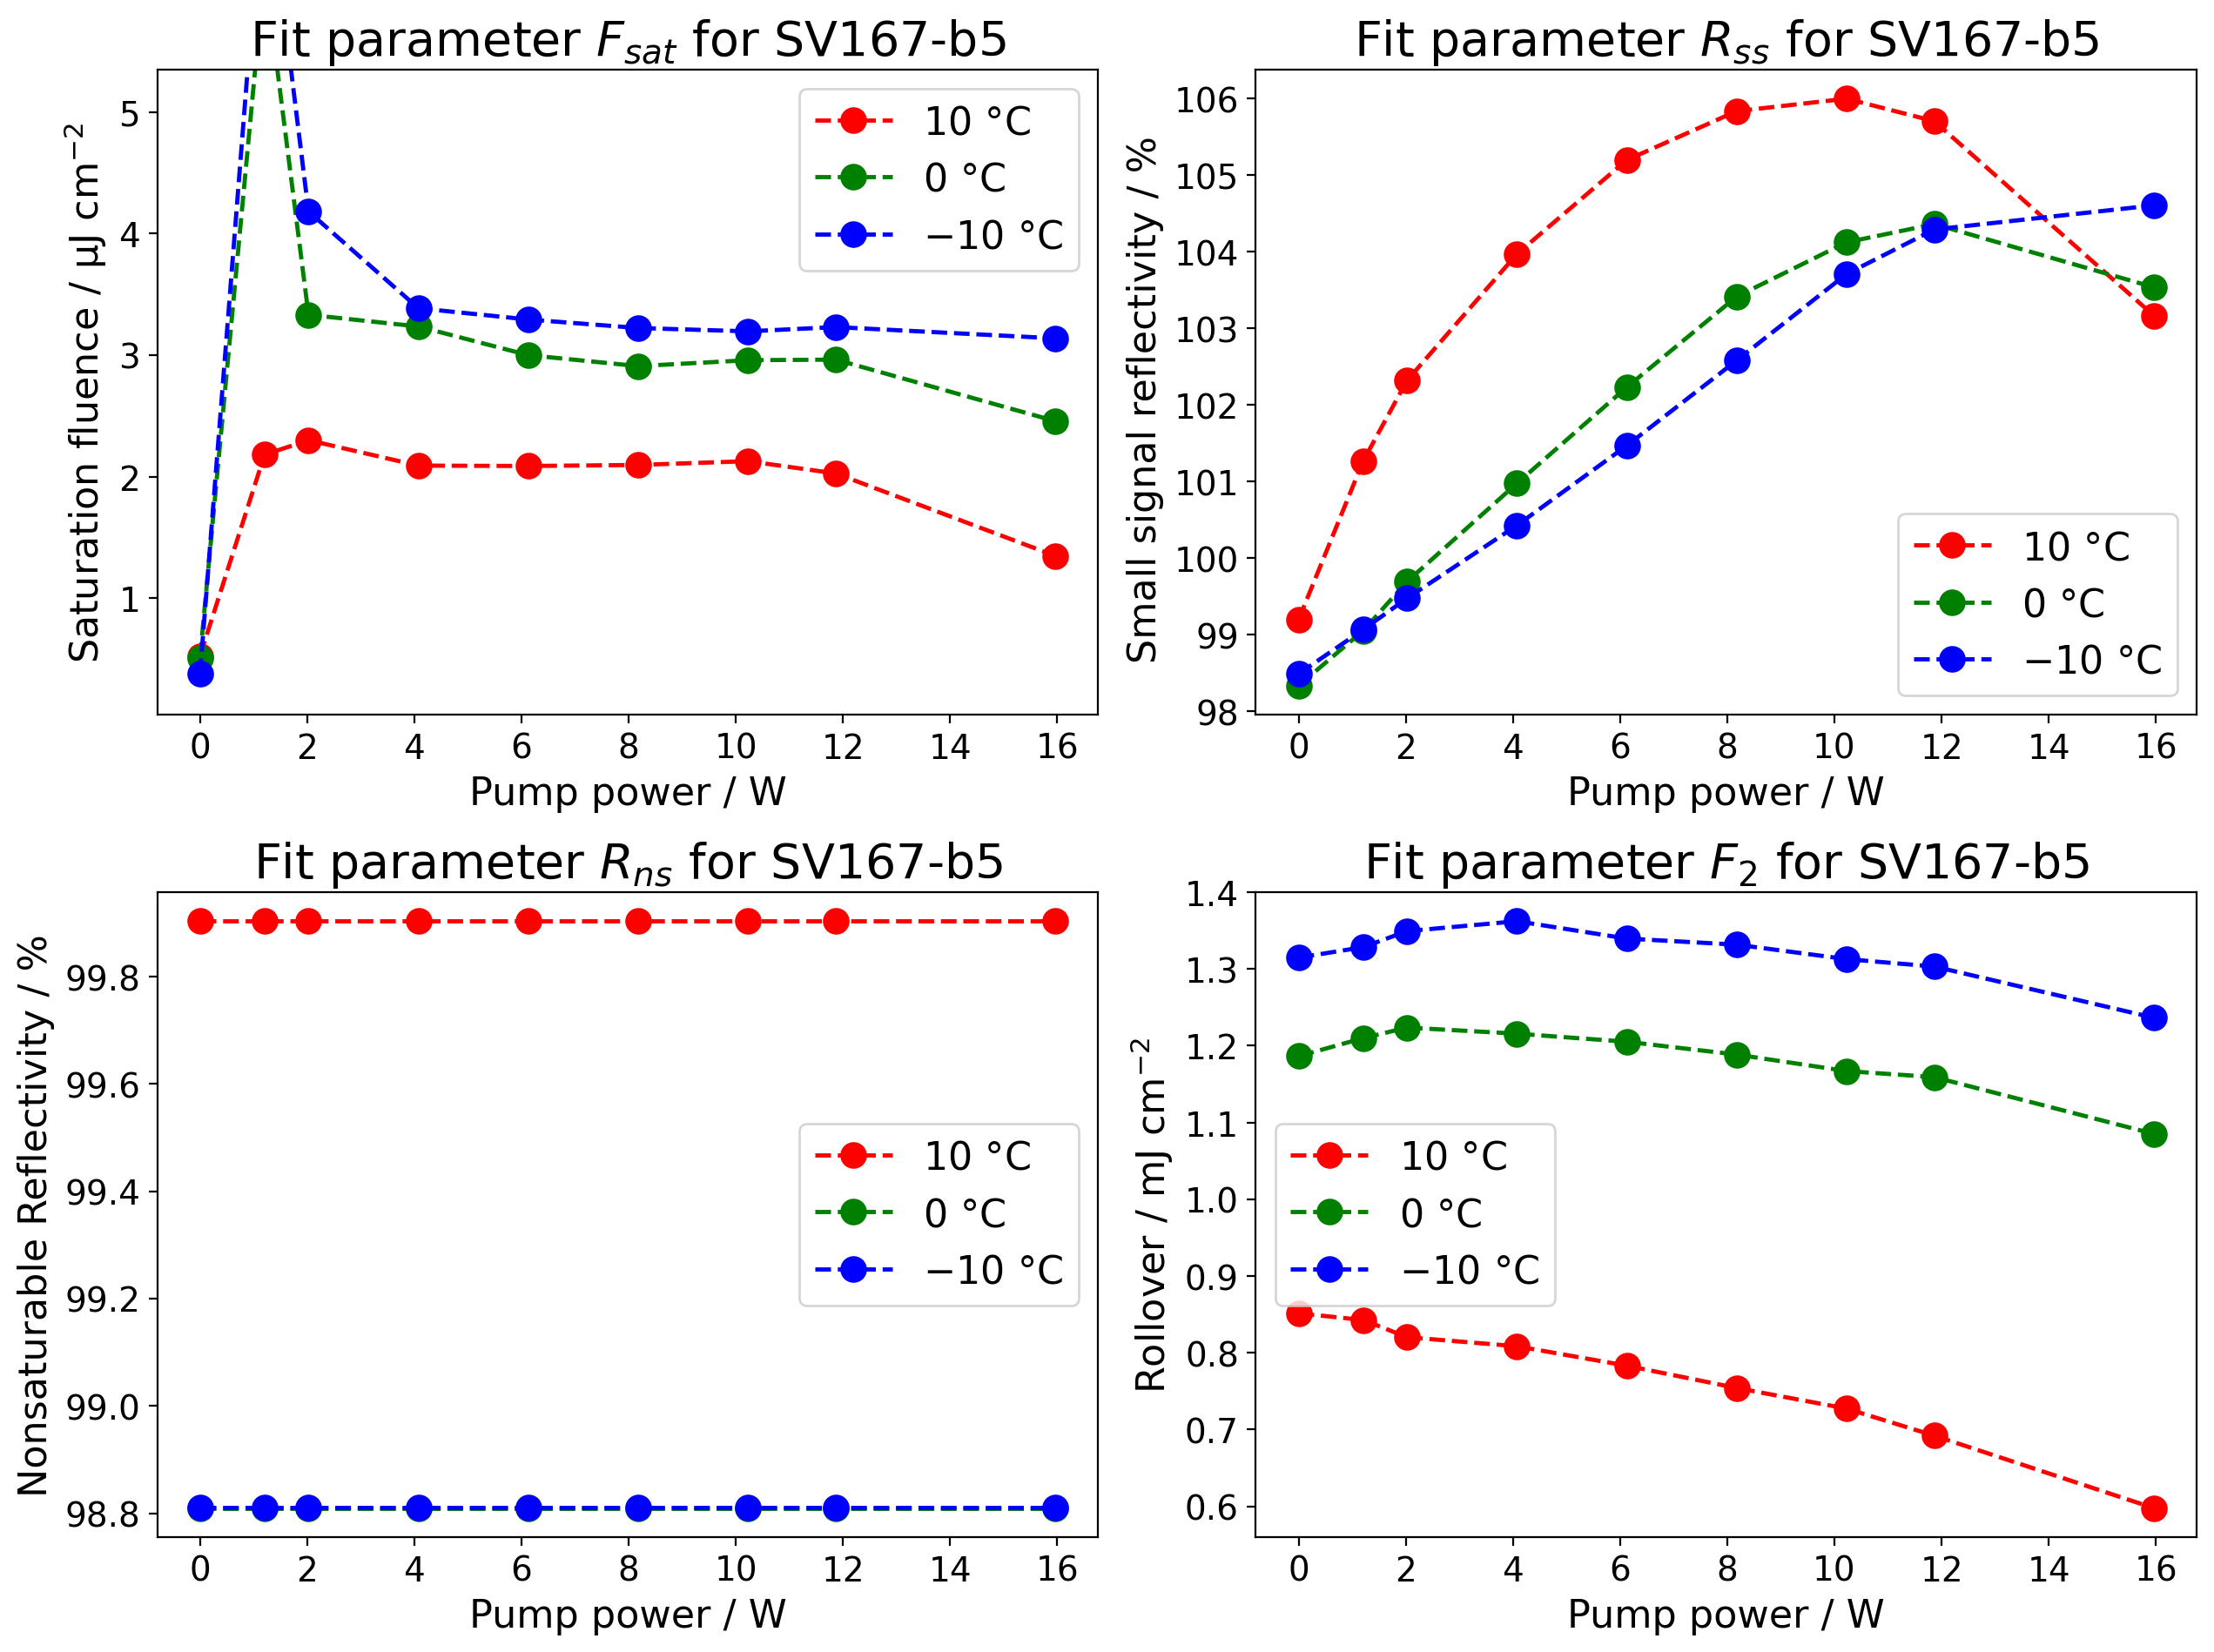
Overview copper, pump DBR
0 °C and -10 °C overlap

Slide 28
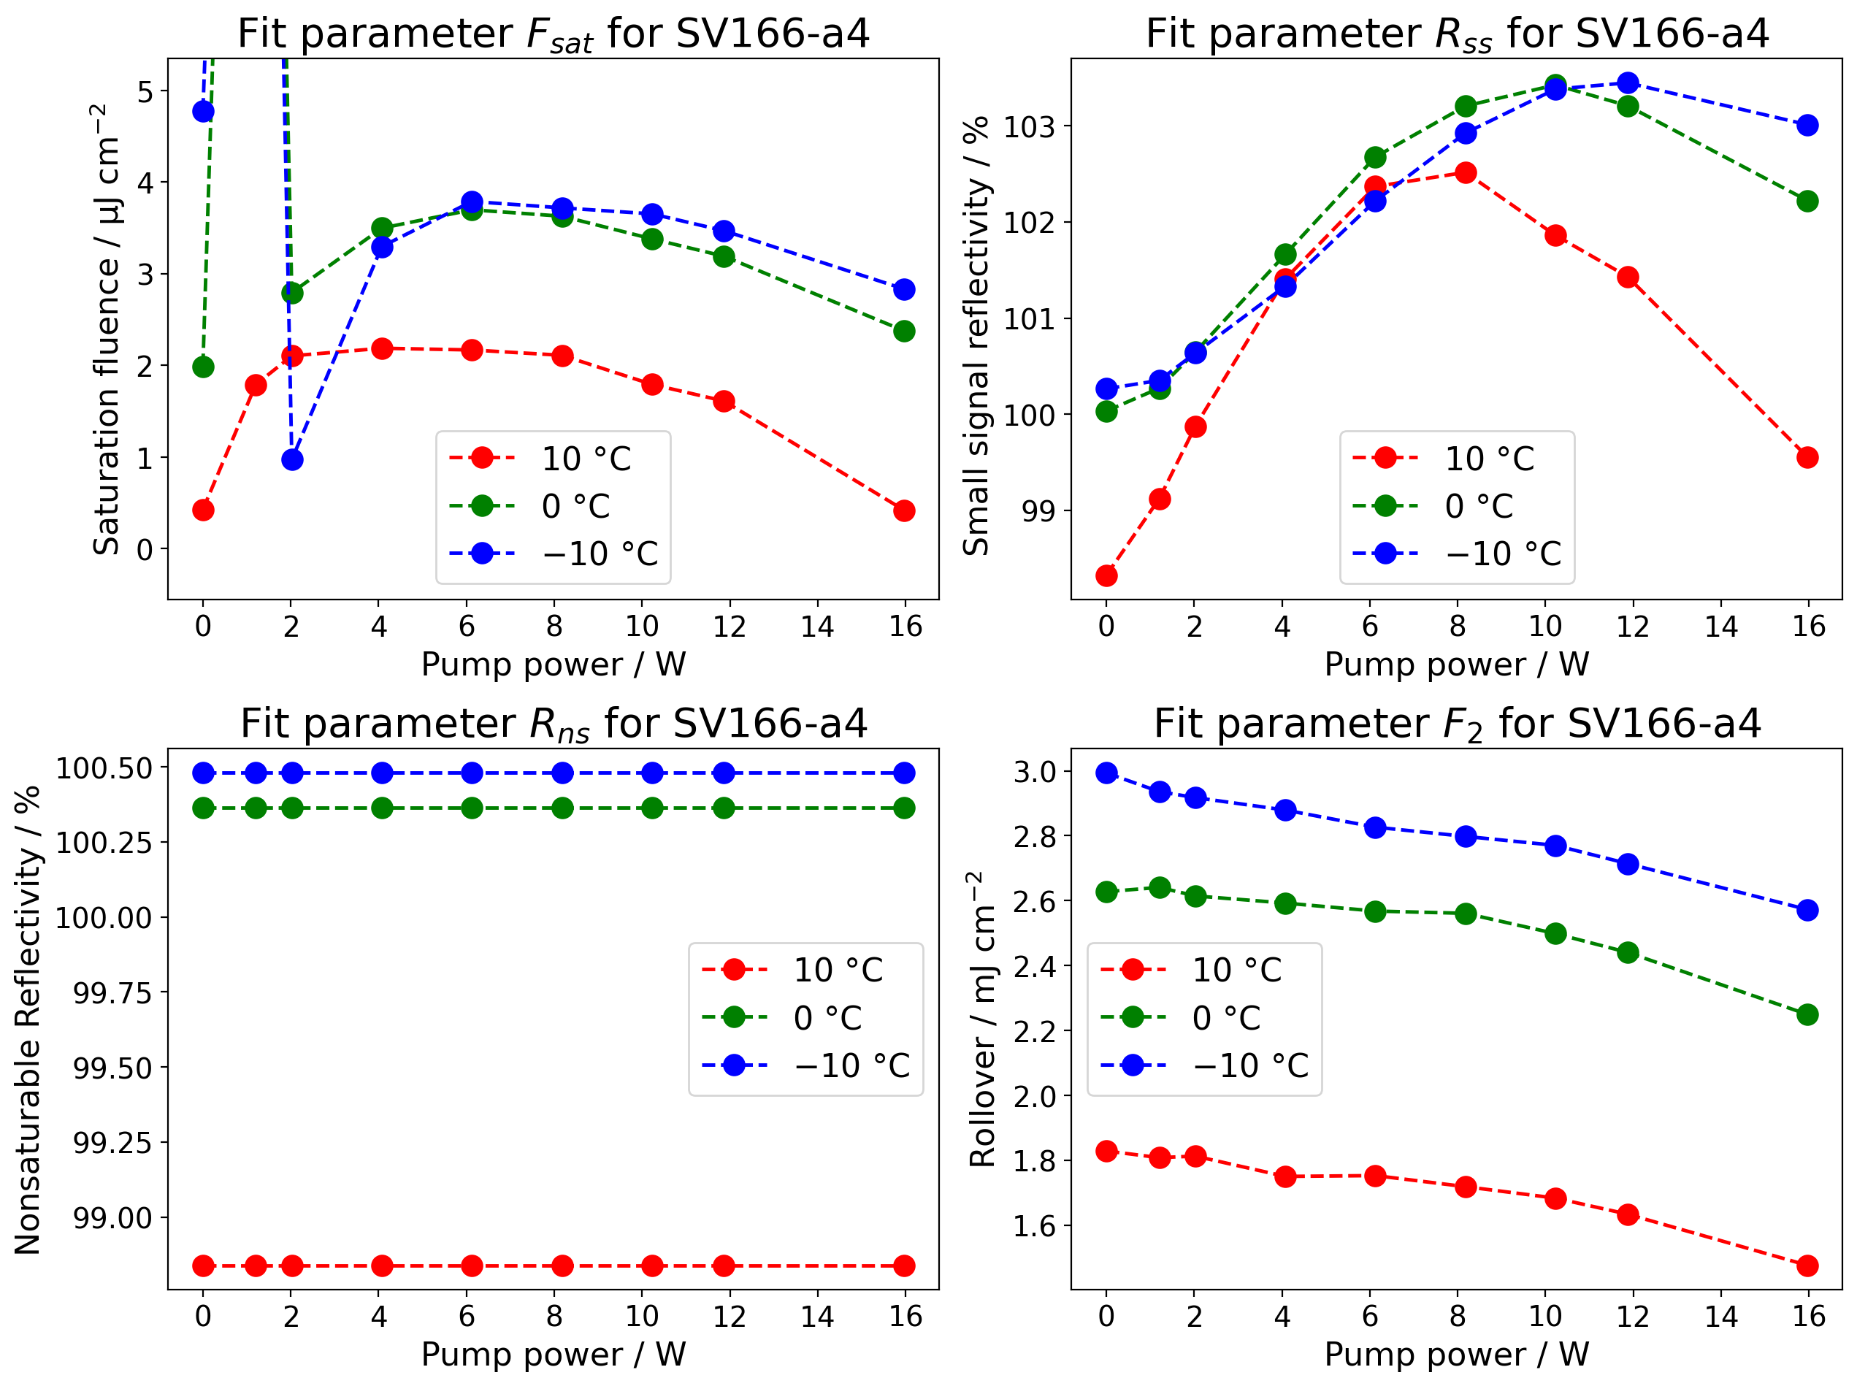
Overview no pump DBR

Slide 29
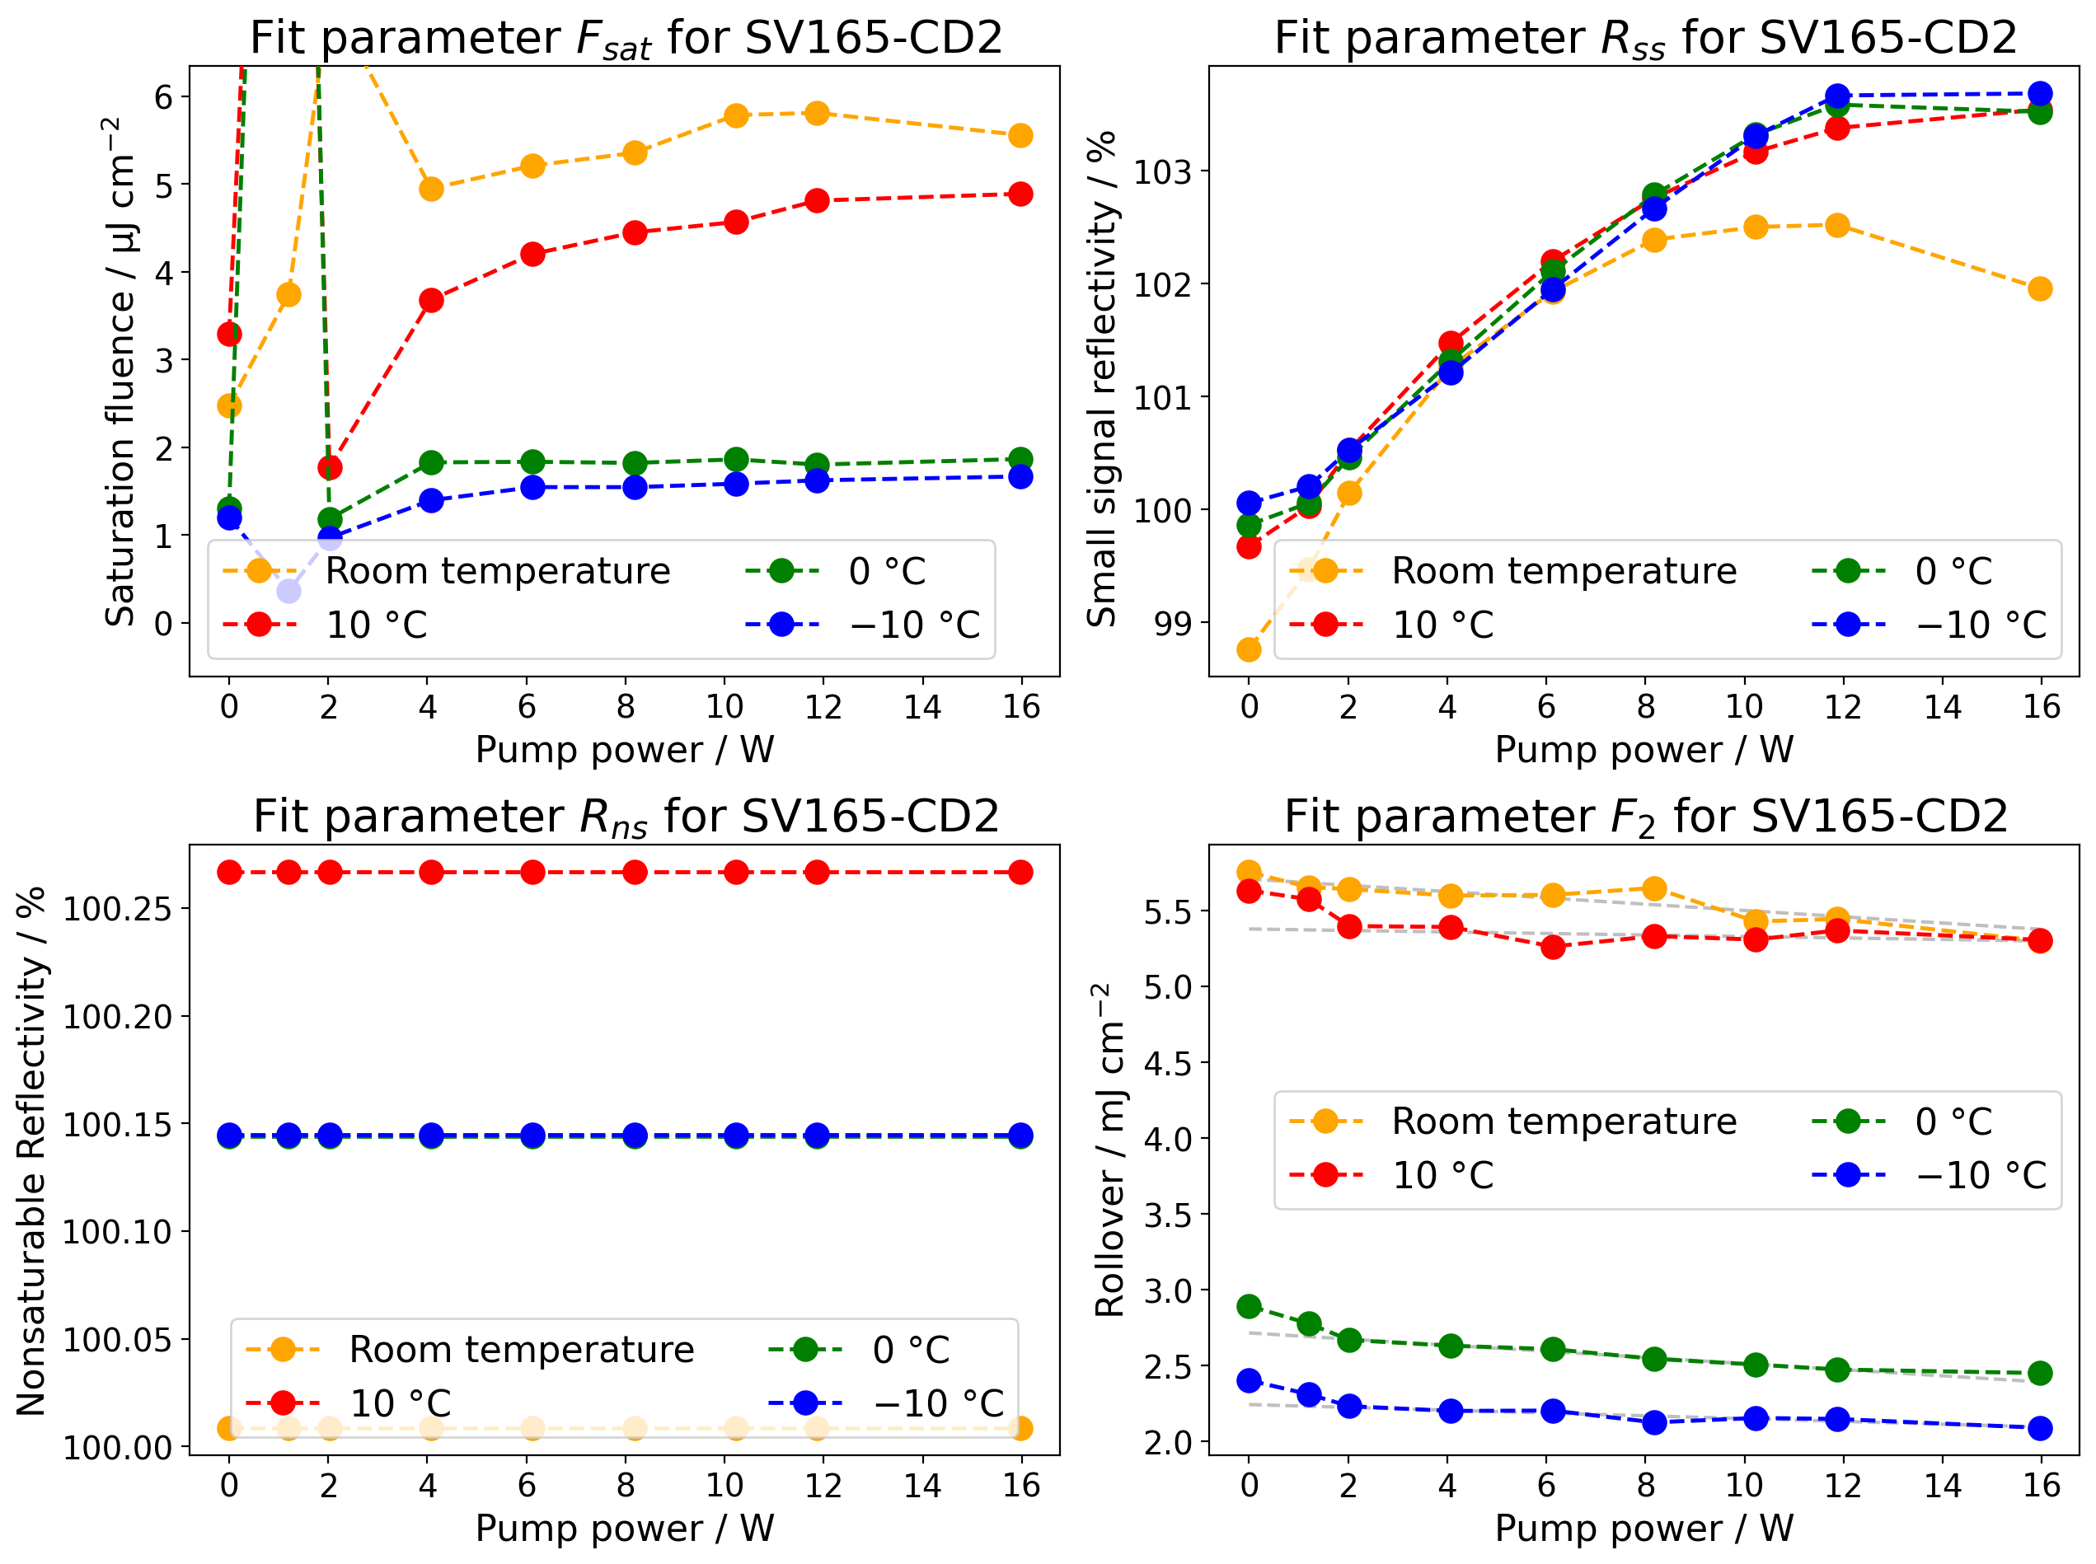
Overview hybrid

Slide 30

Interpretation
General remarks
If we assume the main contributer to F2 is two photon absorption. Then we can say we see an increase in the two photon rate from the temperature. Which has also been reported from [1]
The temperature effects in saturation fluence and F2 can also come from the resonance shift due to thermal expansion of the QW
[1] Krishnamurthy, S., Yu, Z. G., Gonzalez, L. P., & Guha, S. (2011). Temperature- and wavelength-dependent two-photon and free-carrier absorption in GaAs, InP, GaInAs, and InAsP. Journal of Applied Physics, 109(3), 033102. https://doi.org/10.1063/1.3533775

Slide 31
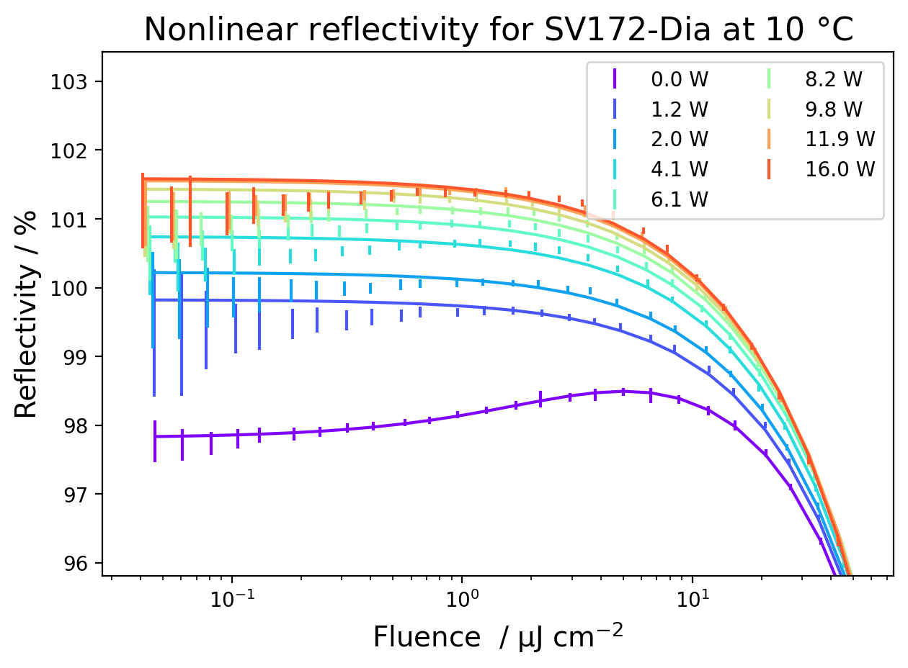
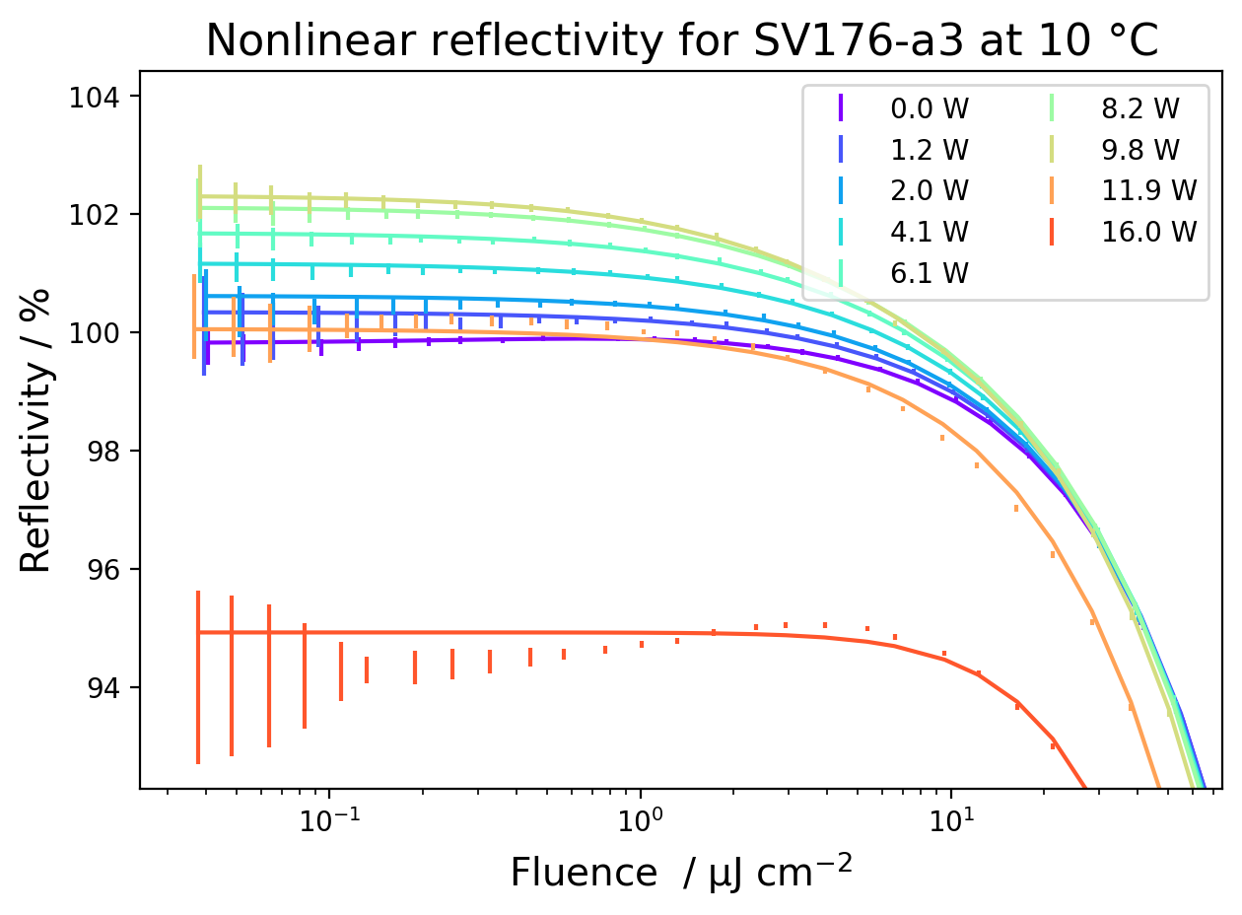
Gain saturation for MIXSEL
Expected a superposition of a SESAM and VECSEL profile
SV172 has a bigger contribution from the SESAM compared to SV176
Does modelock
Doesn’t modelock

